Slide 1
Role: Security Analyst At Audi Mumbai West
Name : Sanket Keny
Project Guide: Prof. Rashid Patel

Slide 2
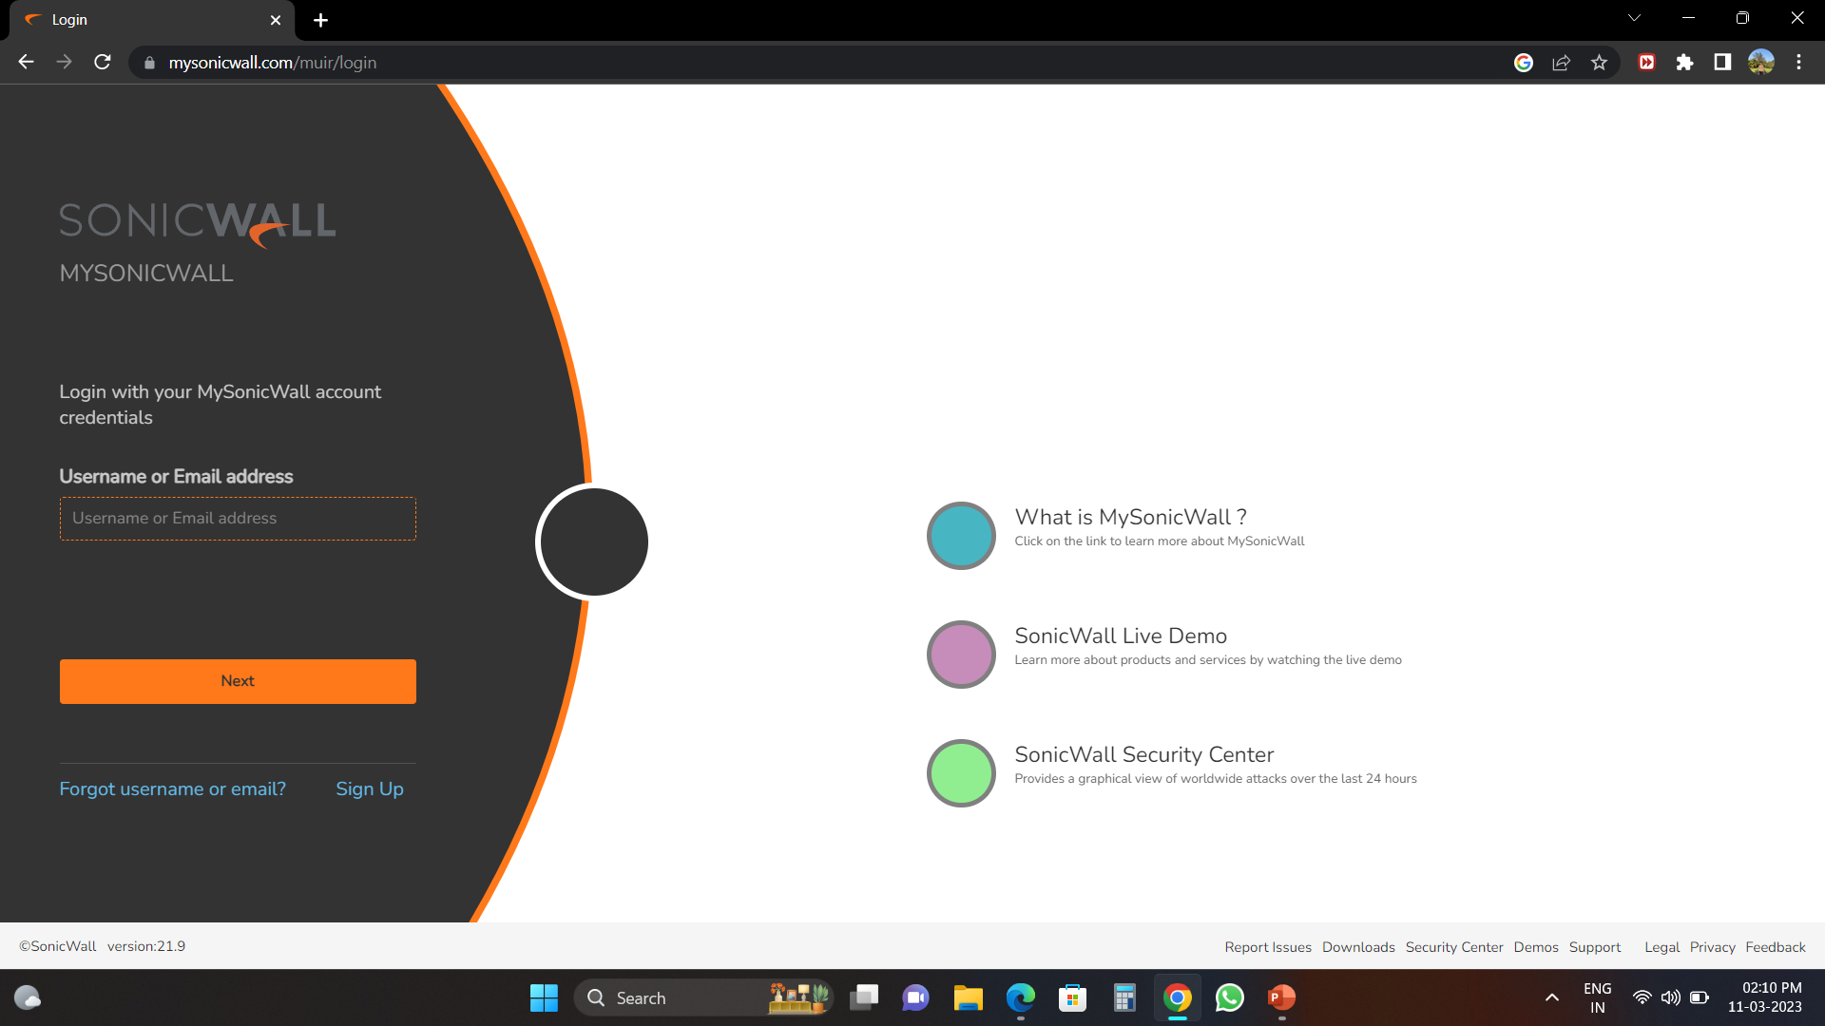
This is the sonic firewall that is used to trace the packets sending within the machine and also monitoring the systems we can detect the amount of hits and wavelength of threat that a system consist of

Slide 3
Sonic Firewall Features:
Managing The IP Address Of the Systems that are currently present in the organization
Creating the tunnel for the SD Wan and subgrouping it
Tracing the packets of all the IP address
Tracking What the IP Packets Are Sent to each machine
In firewall the Malicious packets are subgroup into 3 groups :Green , Yellow ,Red
The Red packets Are considered To be ALERT
The Yellow packets Are considered To be Decision To Be Taken
The Green packets Are considered To be Safe

Slide 4
Sonic Firewall :
Giving Access to the required application to each Machine about their Department needs to work upon
Blacklisting the application IP which are not required
Creating And Managing the inhouse Server Loads in the firewall
Working onto Building its own SD wan box and Handling it on

Slide 5
Sonic Firewall SD WAN:
We are creating a single SD Wan server where we can load And keep its Tunelling through one single Channel
Through This we can have one single Access to its Bandwidth To be Shared across all the location
We can optimize and share the frequency according to the location needs and its limitation
Main features of this firewall is that we can Have two multiple lines to work onto and even if one line gets downgraded it automatically shifts its focus on the another line

Slide 6
SD Wan Sonic Firewall Features:
It has the lowest latency and can be configured
It has the lowest jitter
It has a very good number of least packet Lost
Subgrouping of the various channel can be done
We can see the status of the latency

Slide 7
Why we Choose SD Wan
It has a basic Failover in terms of network handling
It has a Round Robin feature enabled which saves packet loading
A good Spil Over ratio can be set
Bandwidth management ( High Priority , Low Priority can be set at a frequency of 0 to 7 where 0 being lowest and 7 being the highest)
It replaces MPLS and leasline
And thus saves a large amount of cost

Slide 8
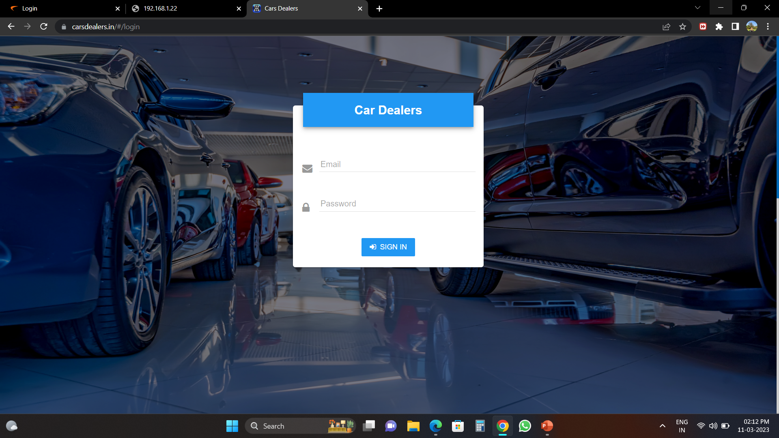
This is the car dealer page where we add/edit each company cars and its variants as well its subvariants

Slide 9
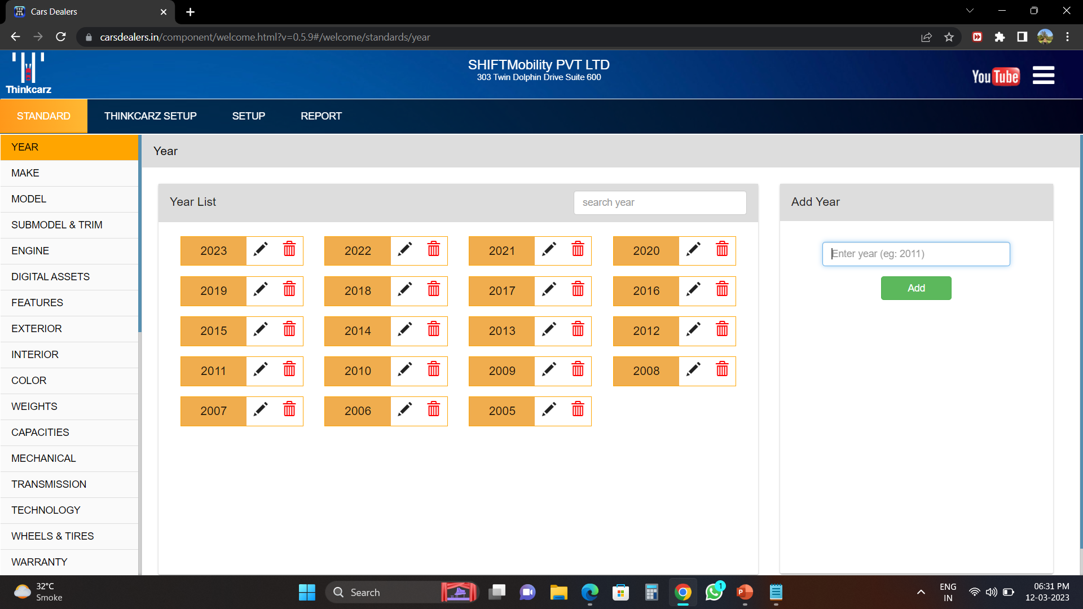
We have an overall view in which year the car is launched and when its been issued

Slide 10
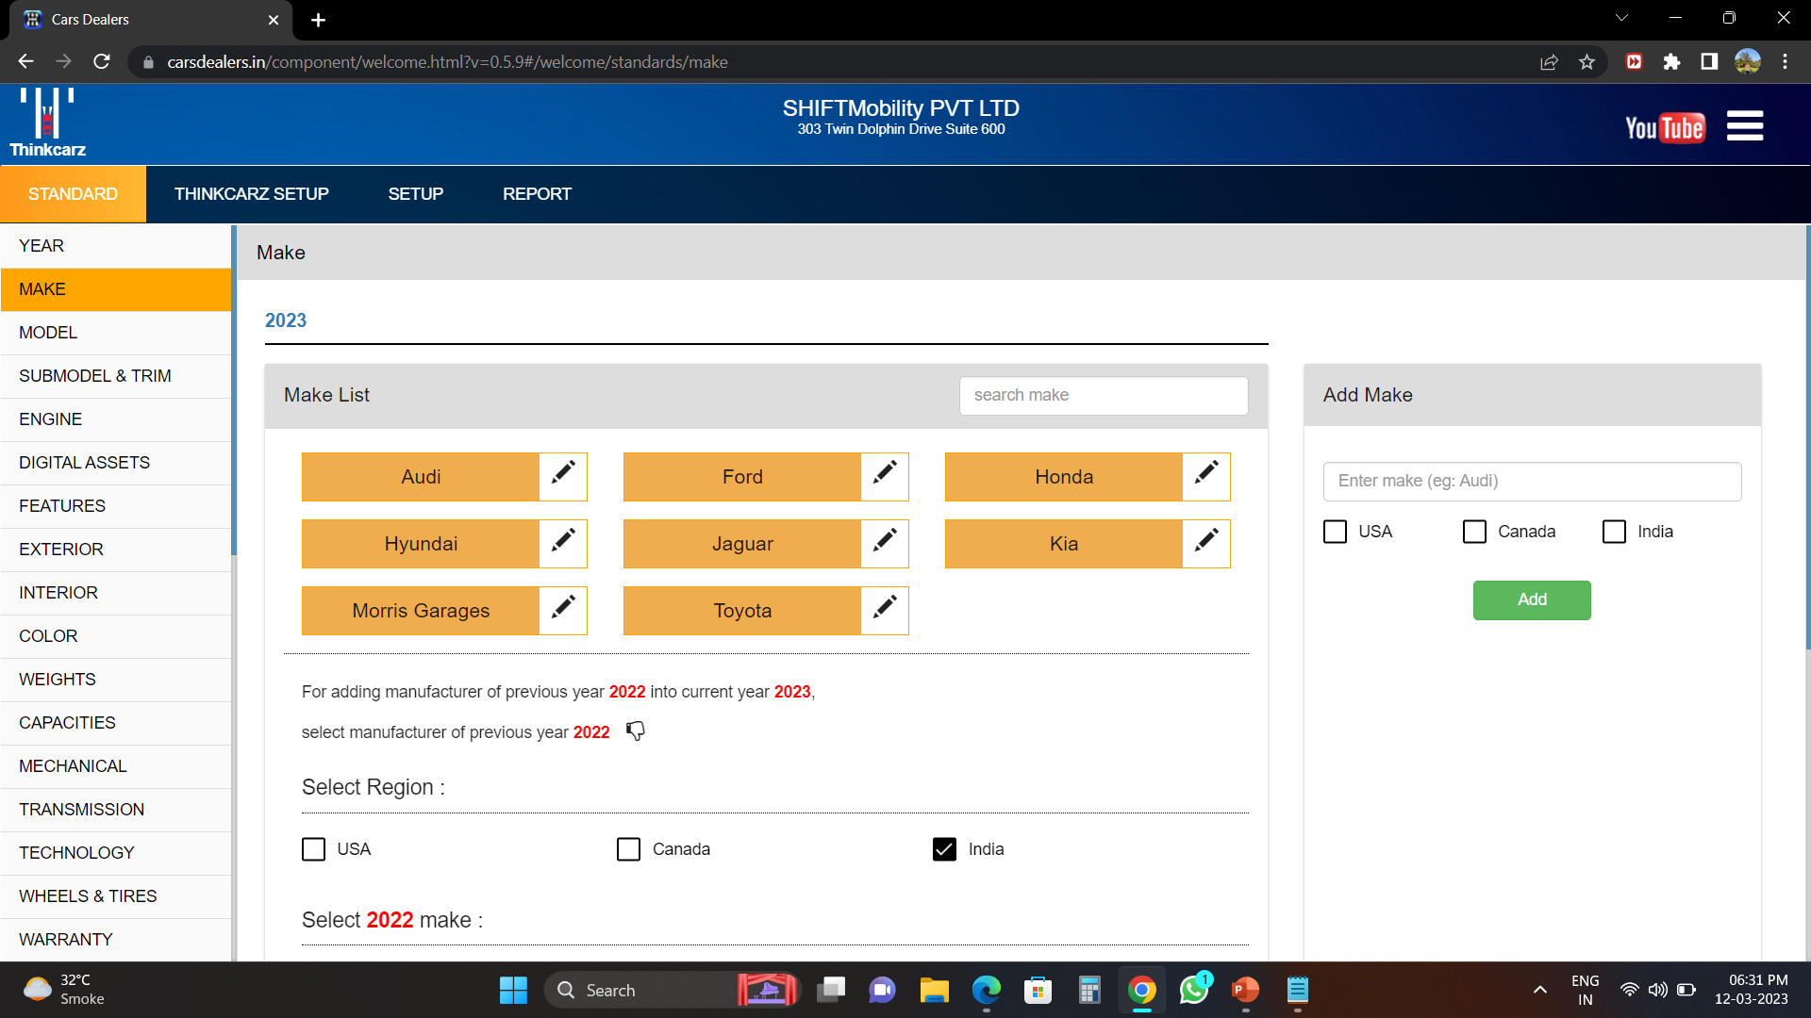
We have multiple brands under which we work are been stated below in the list

Slide 11
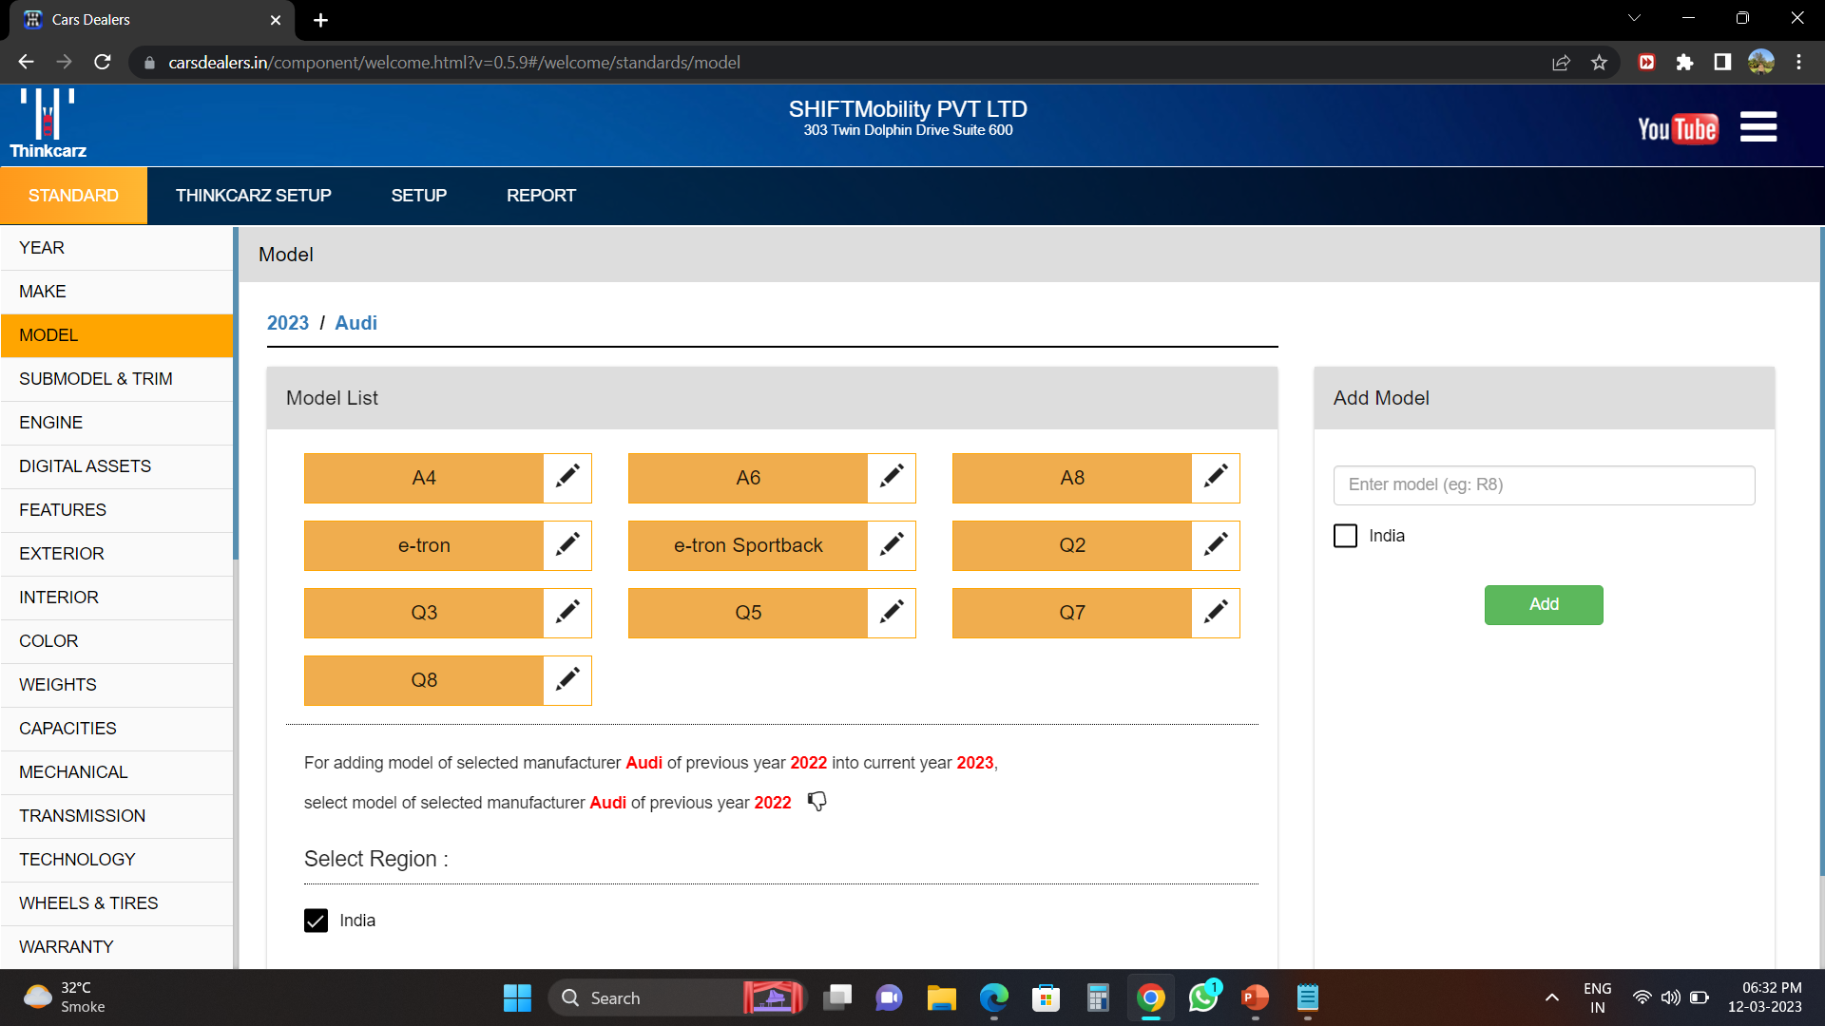
The model list of the audi cars are been listed here

Slide 12
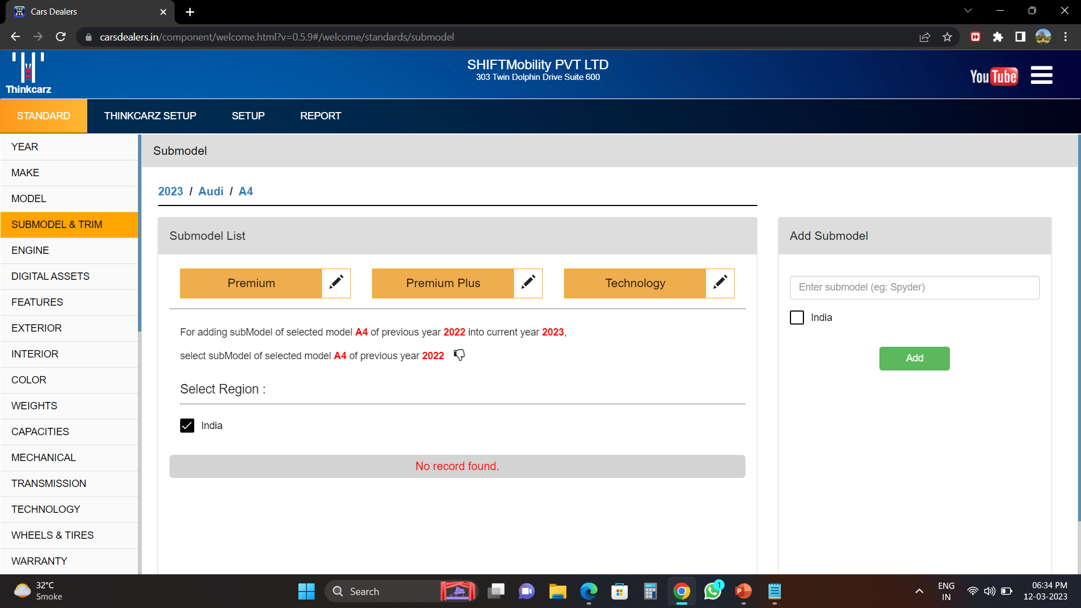
Its variants and many subvariants does it conclude of

Slide 13
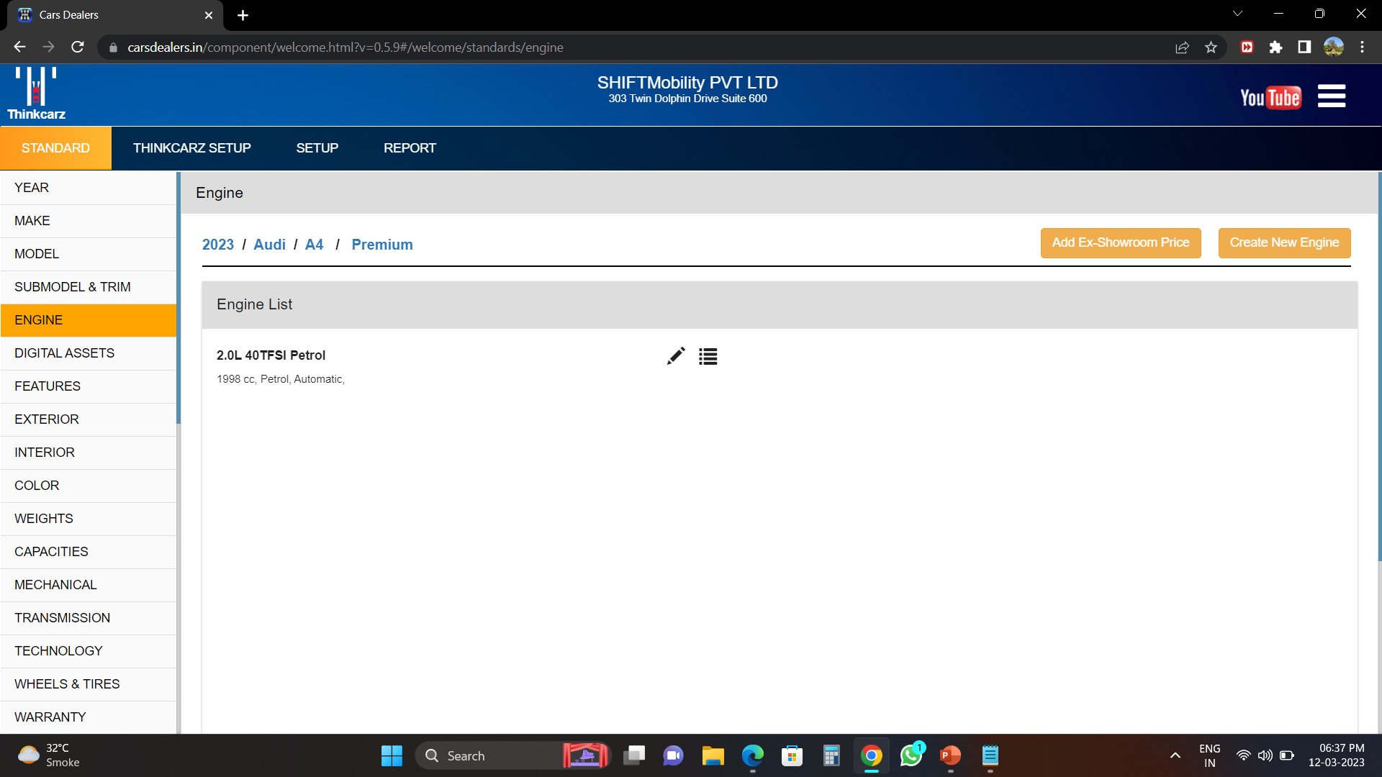
We have the subvariant where we define its configuration its pricing and its indepth details

Slide 14
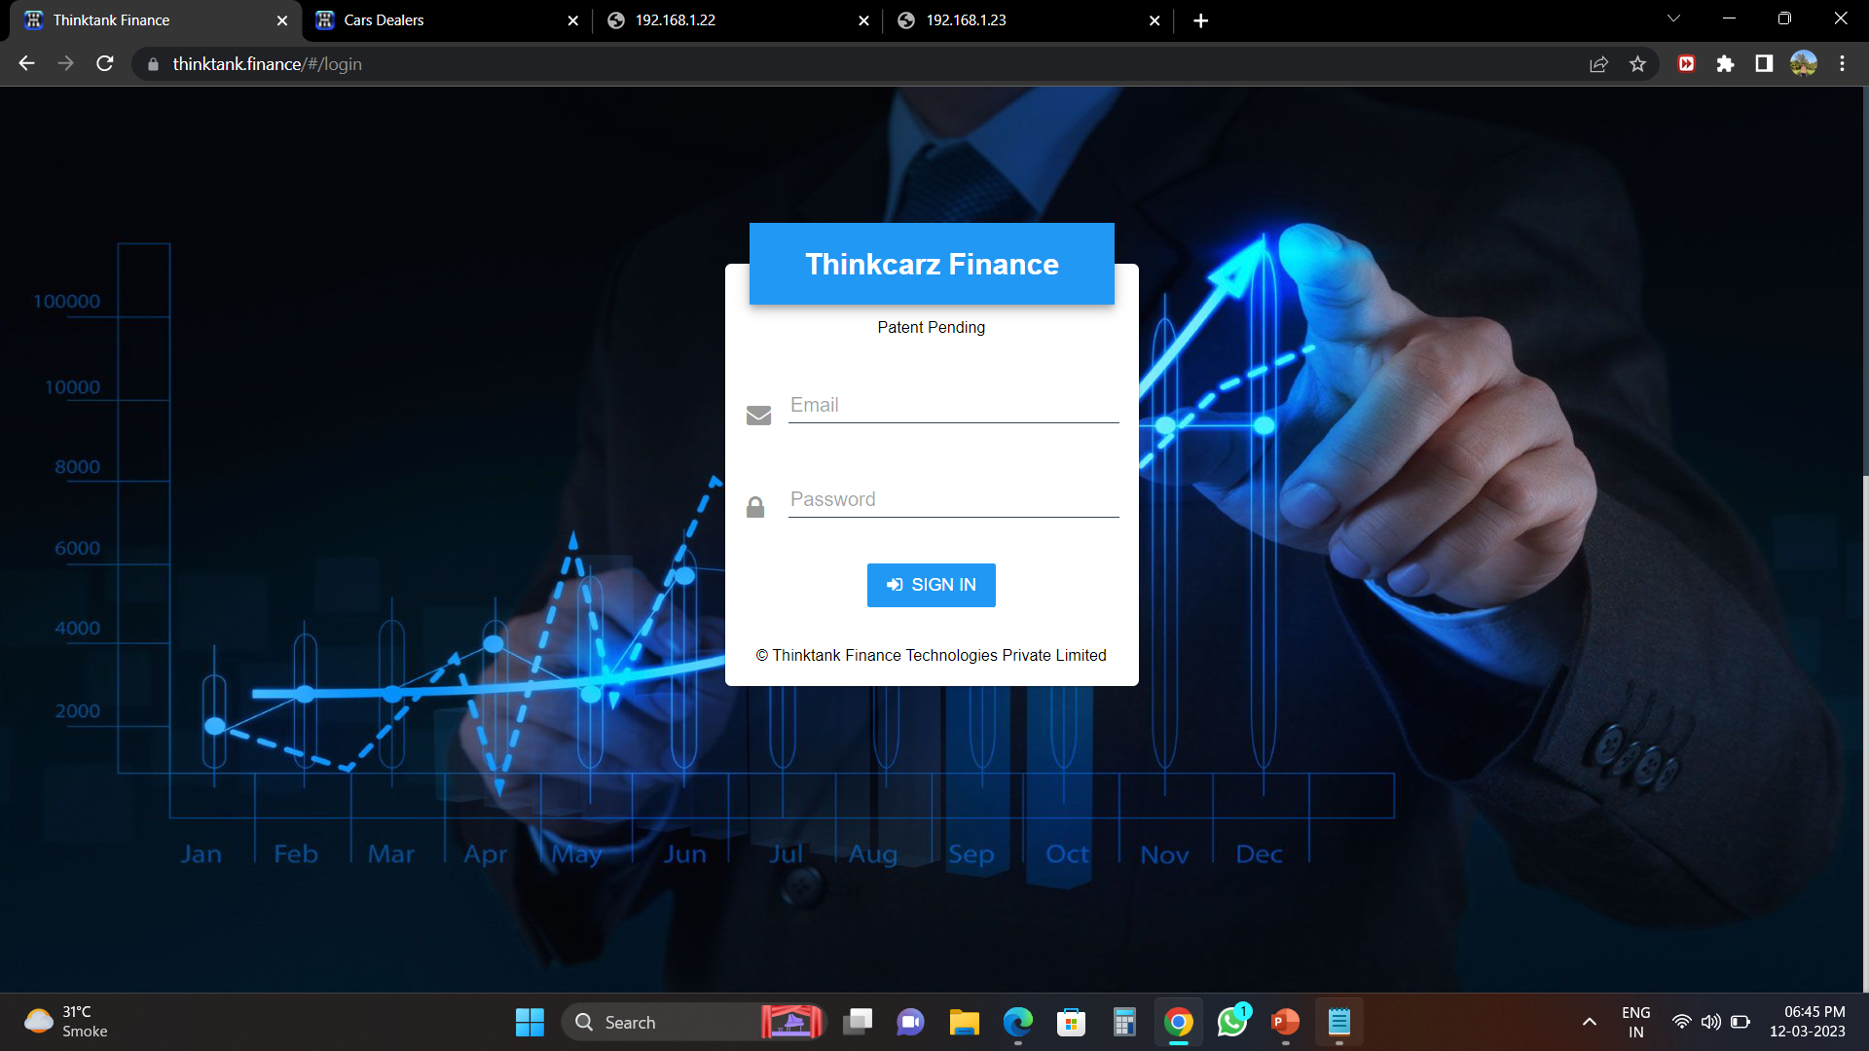
This here is the Thinktank finance page it is mainly used by auditors and loan department of the company

Slide 15
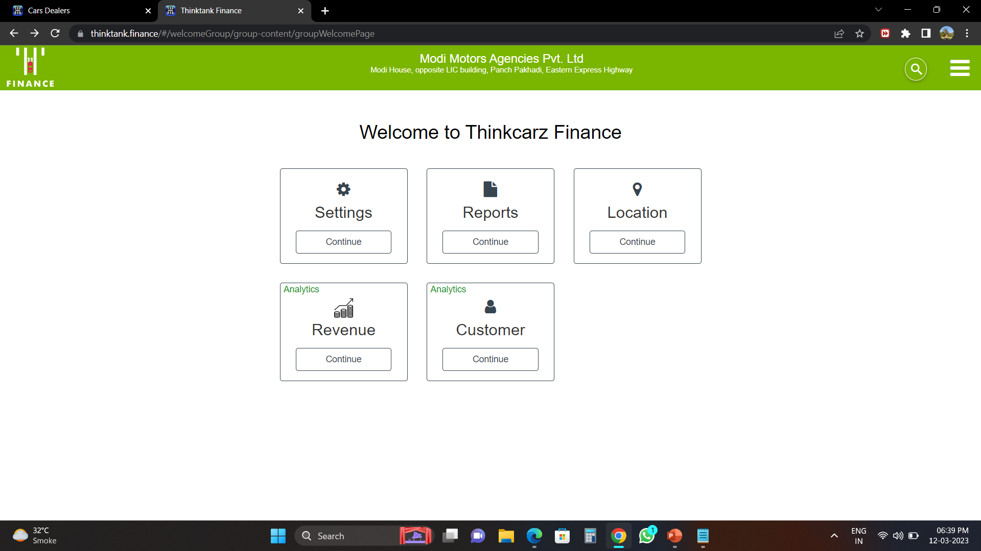
This is its home page where we can see revenue page and its settings version

Slide 16
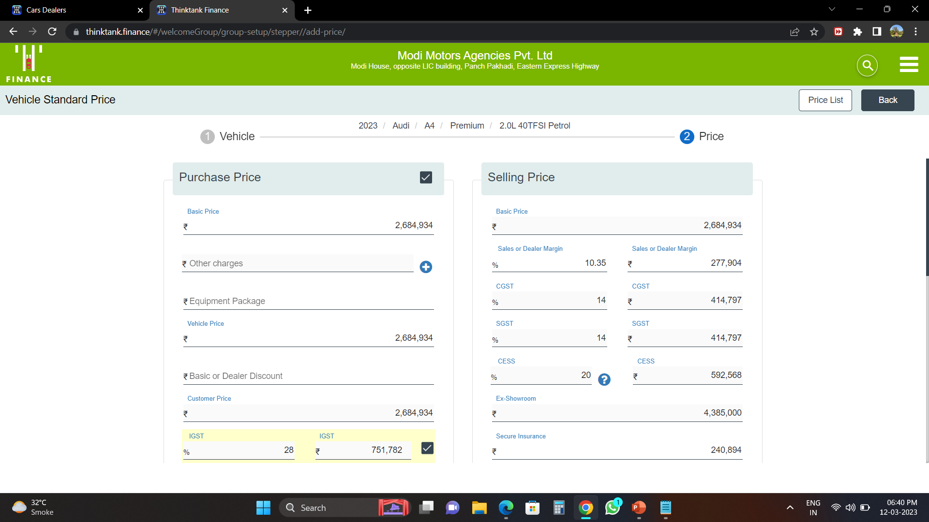
Here we have the each breakup of the car here we can see the audi A4 premium breakup price at the amount its been bought by the dealer the percentage of GST to be paid to dealer to company the percentage of CESS that is been charged and the selling price to the customer and its breakup

Slide 17
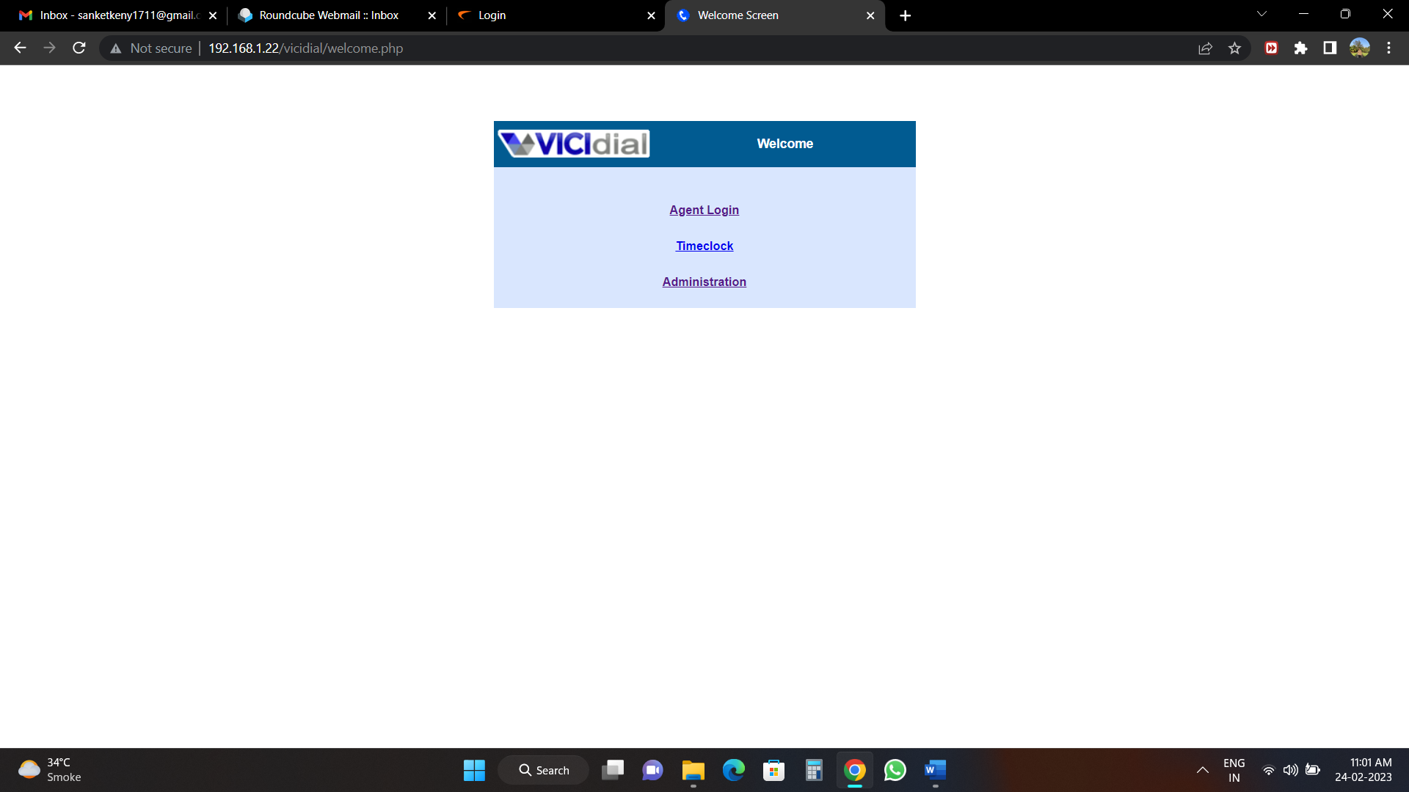
This is the vici dialer used by telecallers its main use is to get the customer data for car upgrade or to exchange the old car to new

Slide 18
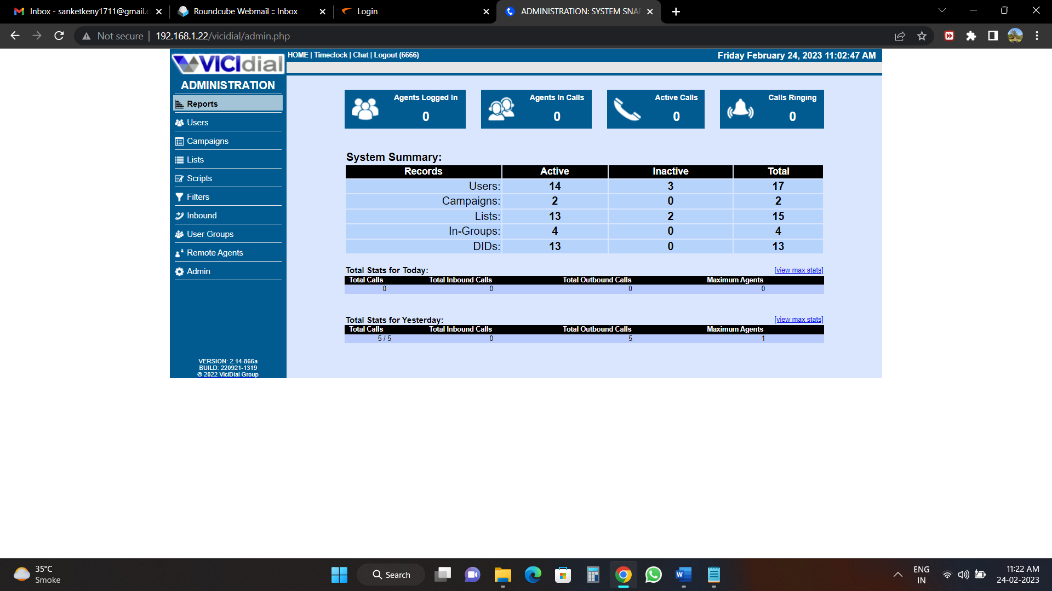
Here we can see the number of users that are currently logged in to the system their status and what campaigns are the into

Slide 19
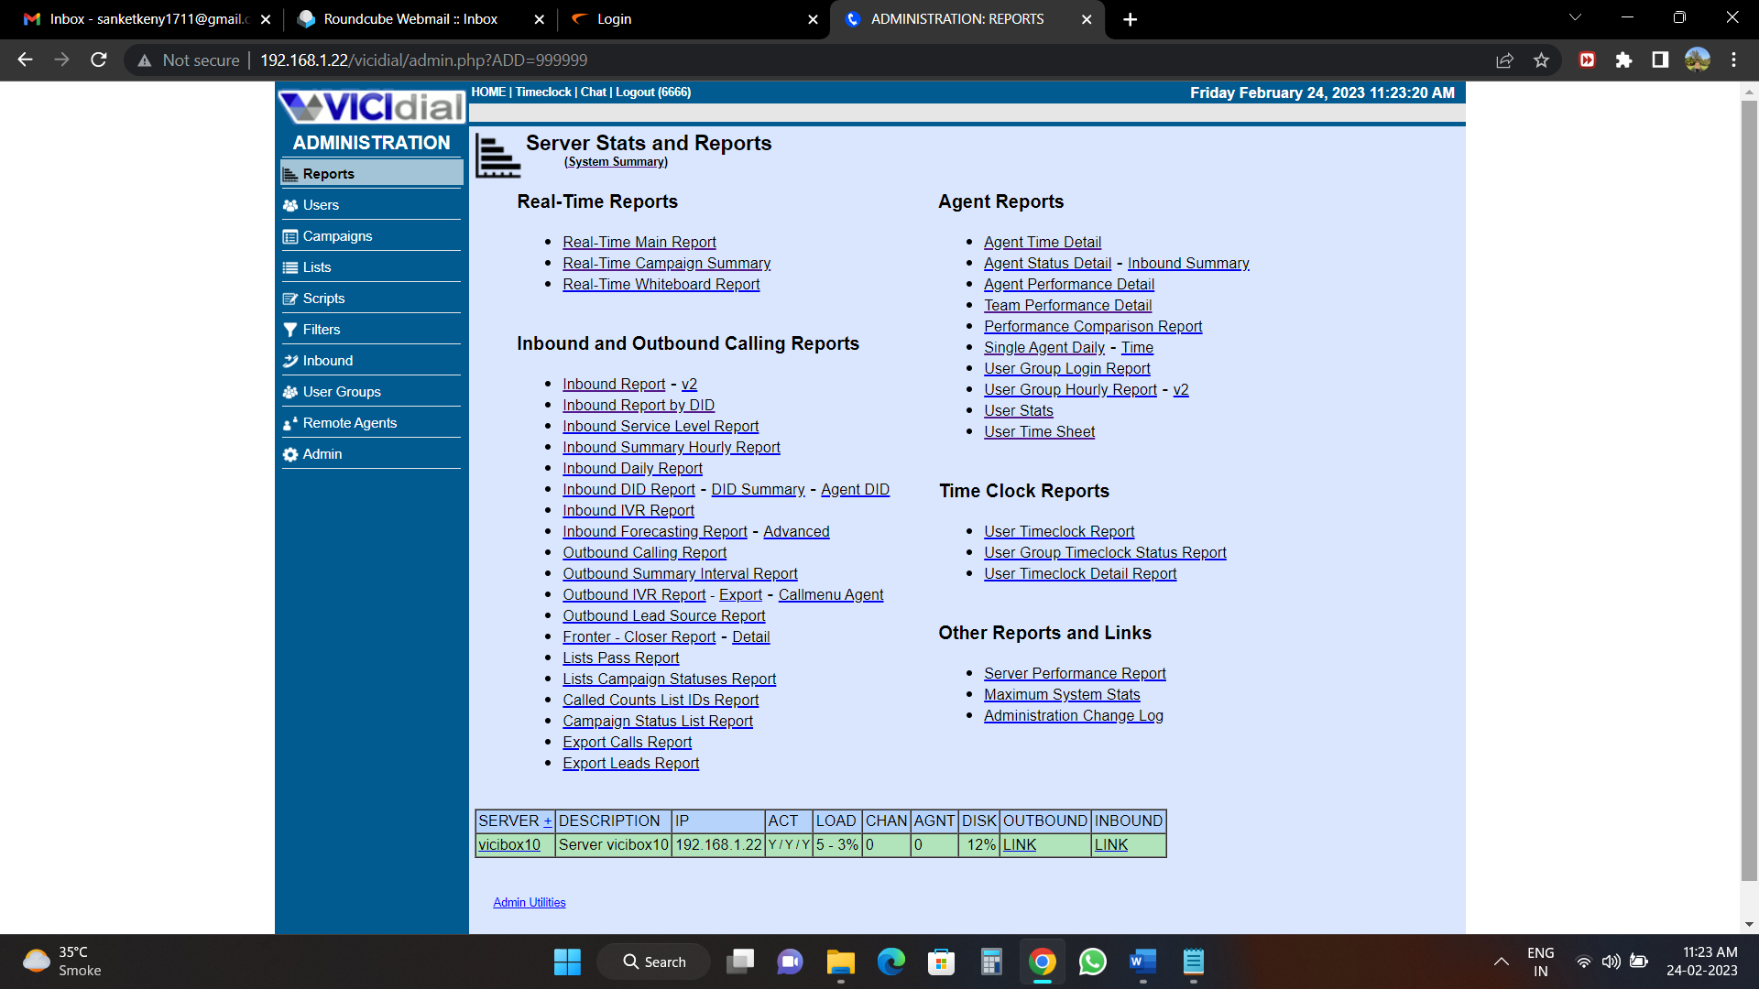
We can get the detailed report of the callers here how many customers are intreseted and how many are not connected

Slide 20
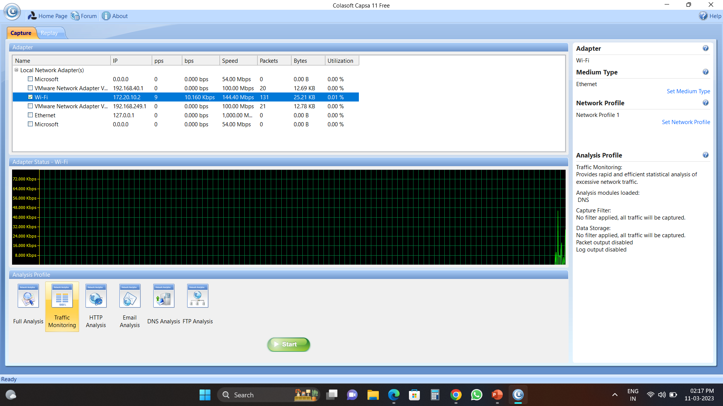
Here This is Capsa Software that is used for traffic monitoring and used to detect on which machine is having most number of hits coming through

Slide 21
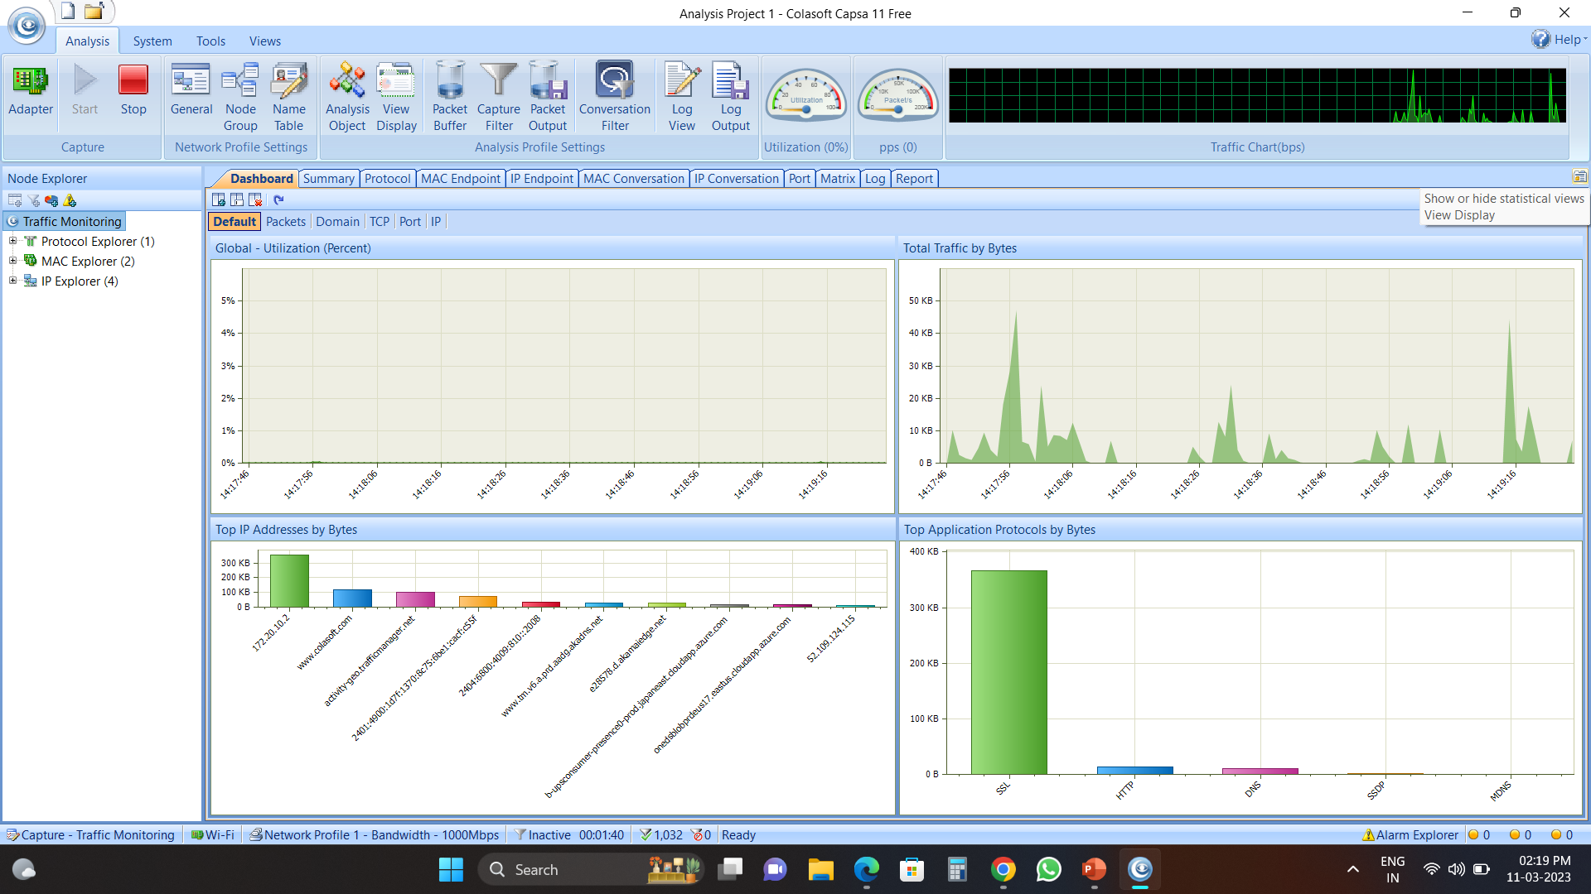
We can get each details here on which IP its been getting hits and what percentage of bits are getting Hits

Slide 22
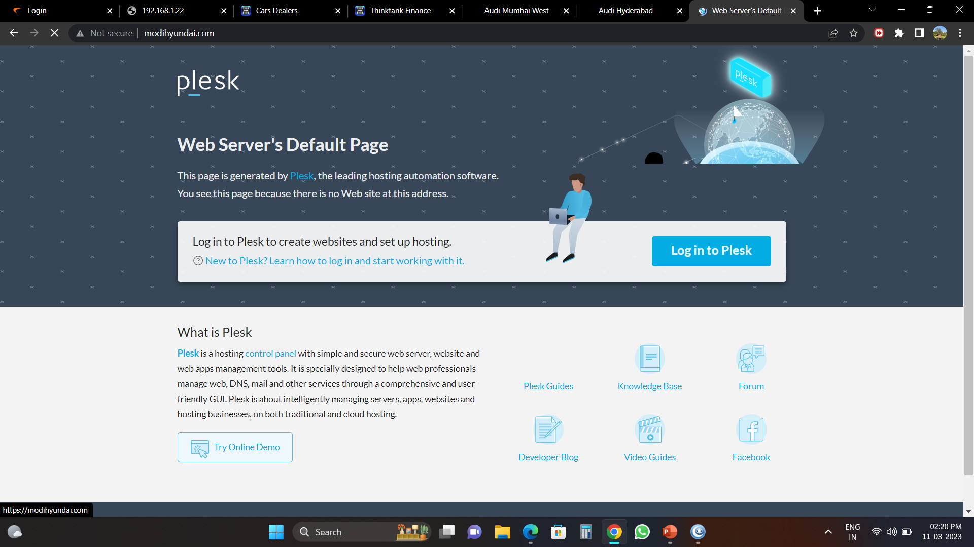
This is our future project a website named Modihyundai.com has been shut down due to domain issue we will be working on its construction as well to bring it on live

Slide 23
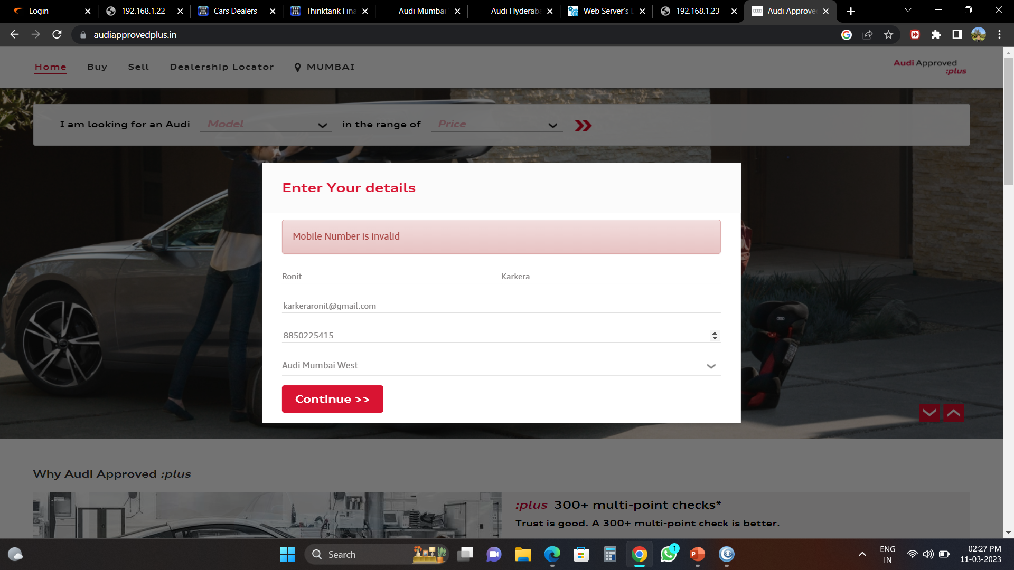
WE have A page called as Audi Approved Plus where pre-Owned cars Are being sold We have to check its maintaince and its hits regularly

Slide 24
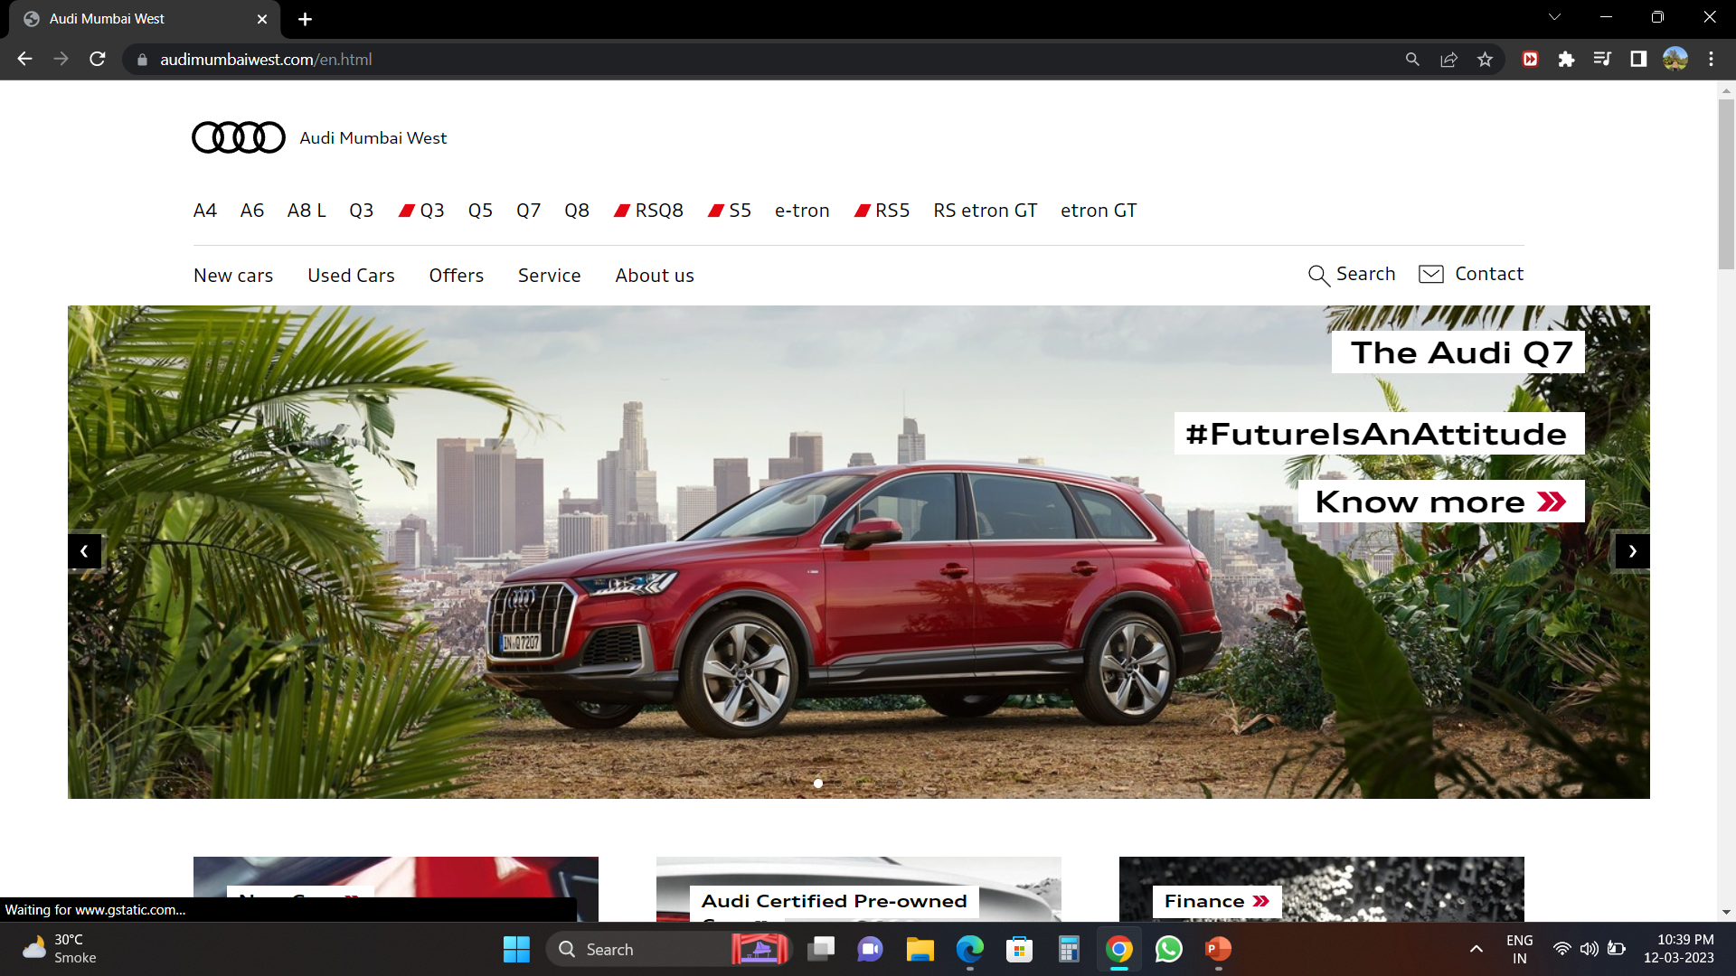
This is the Audi Mumbai West Page where we have to check for new vehicles are being added to its system and also have a look of its working

Slide 25
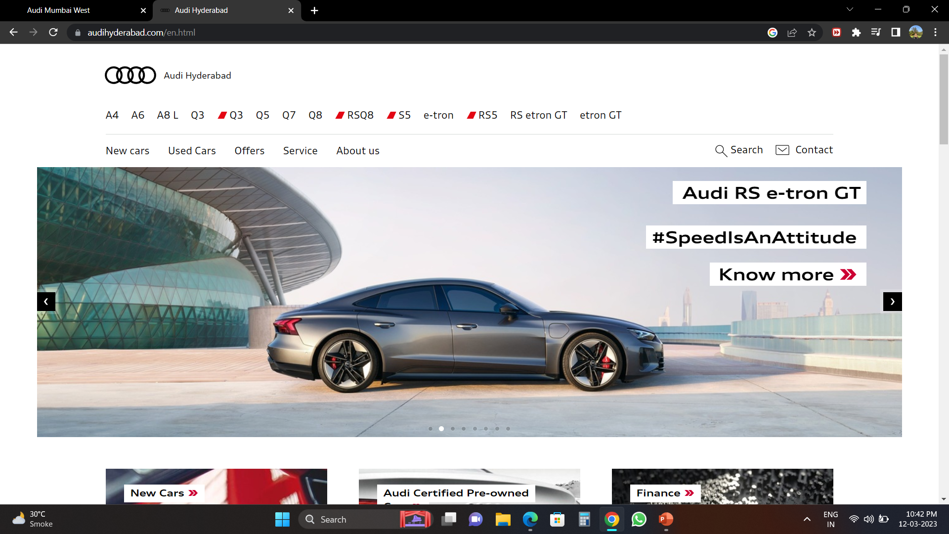
This is Audi Hyderabad Page where we have to look for its smooth working and if any gltich or issue we have to report it to the Audi India Authority

Slide 26
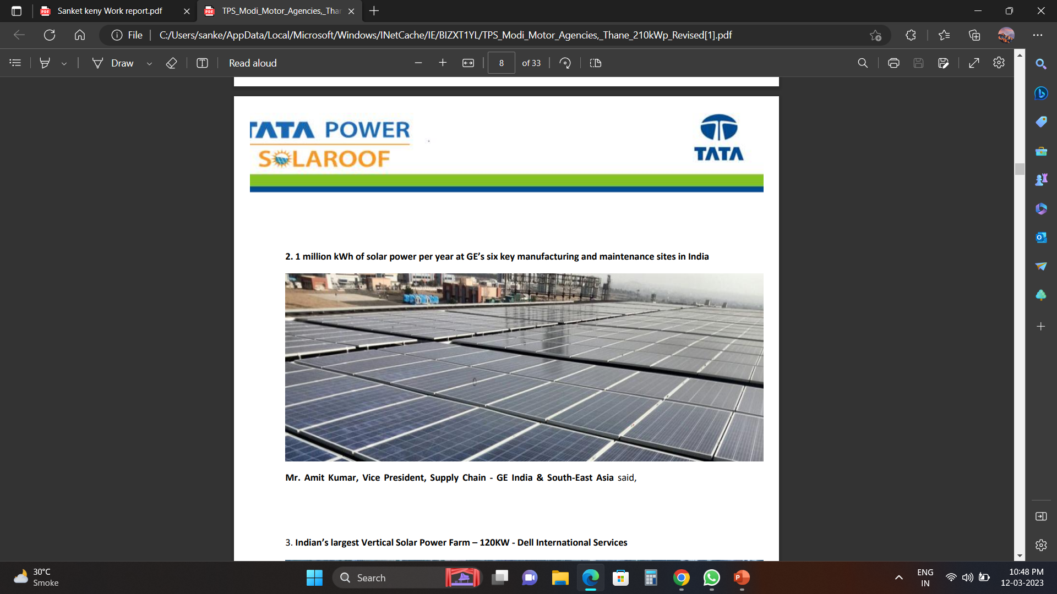
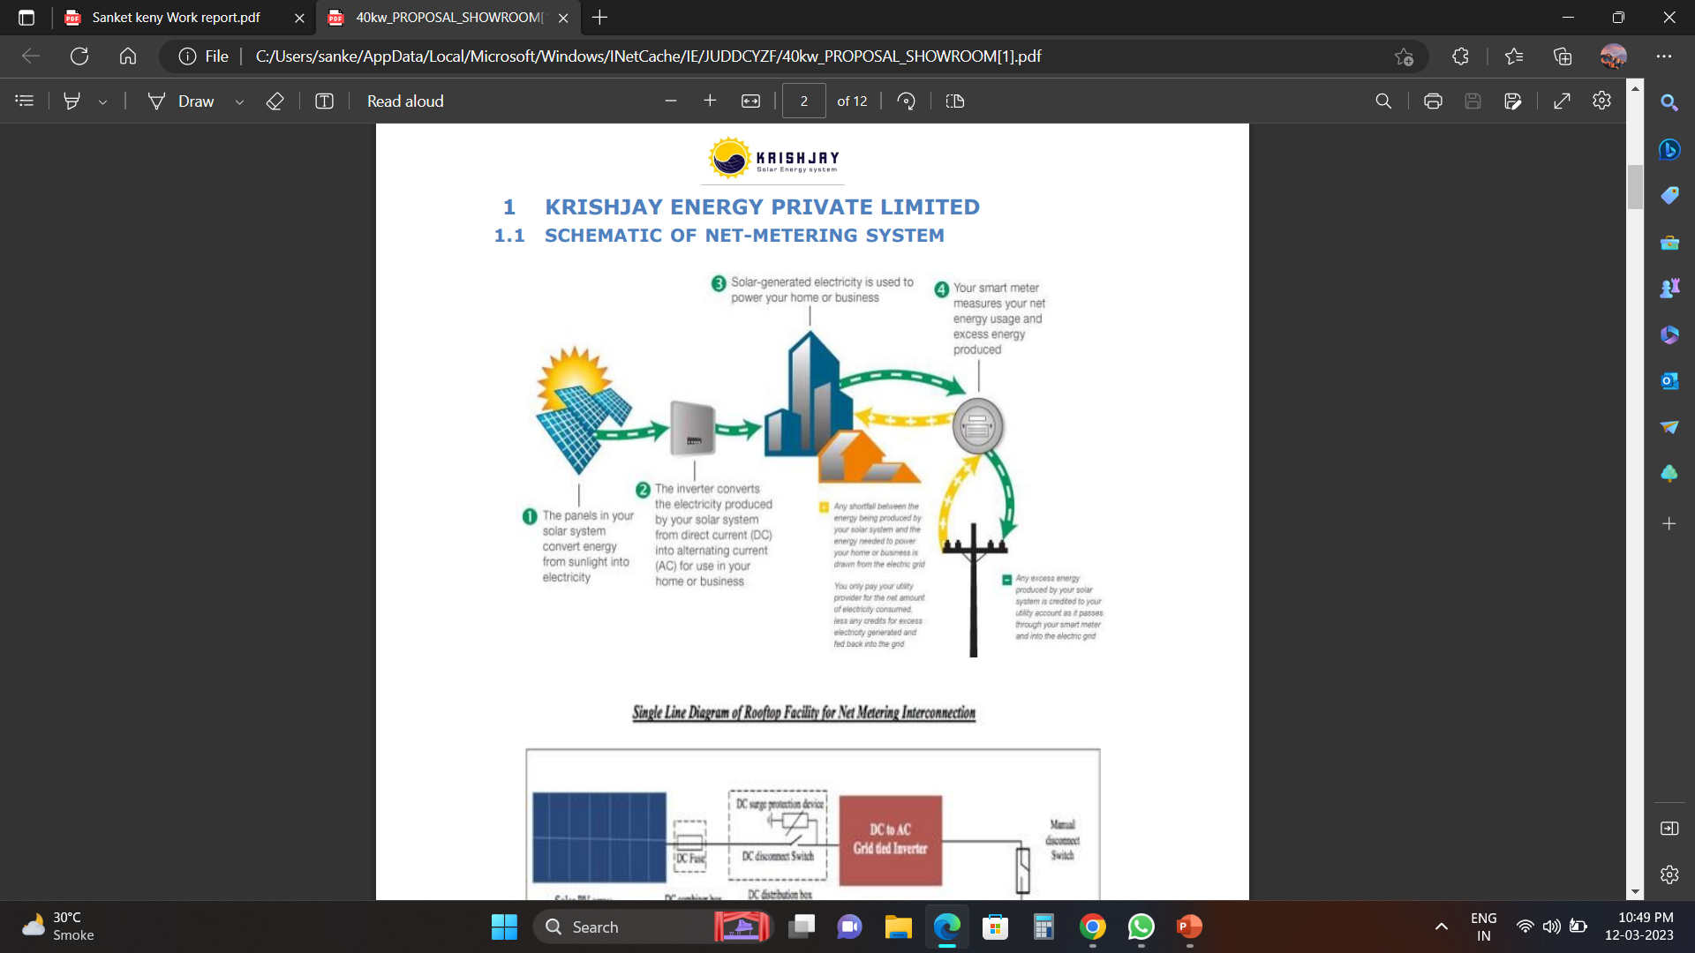
Our Future Projects: Currently we are shifting our focus on solar energy electricity we are in phase to convert our All showrooms as well as workshops to solar energy in the coming years We are negotiating with Tata Power And other brands to get the best Deal done

Slide 27
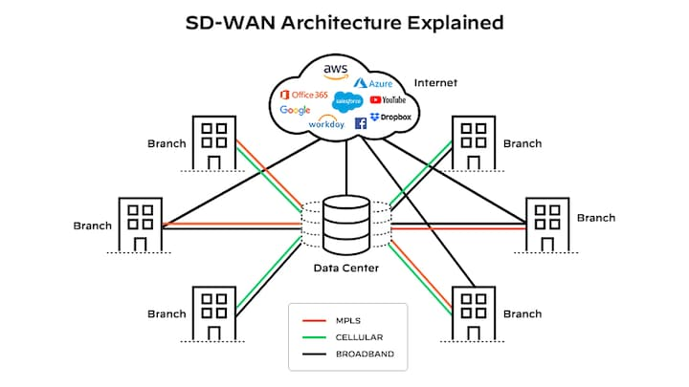
We are also going to install SD wan in our systems as well as to integrate them Also working on dealing with Dell Company for New Enhanced Servers for our upcoming IT Enhancement

Slide 28
Thank you Name: Sanket keny Roll No:4 Msc CyberSecurity

